Slide 1
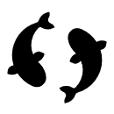
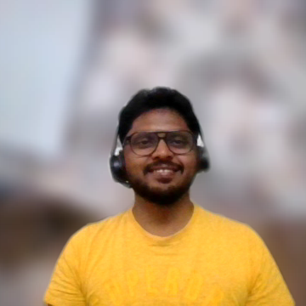
{Code Crafters} Alliance
Nithin Yadalla Ramgopal
Sreedhar Thirunellai Raman
Poothabalan Somasundaram
Rahul Singh
Suresh Kumar Muruganandam
Fish Watch A Livestock Insights product.
Notes:
Good morning, everyone. Today, I'll be presenting the system design architecture for the Fish Watch system crafted by the Code Crafters Alliance for Livestock Insights Inc.

Slide 2
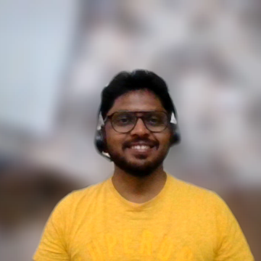
Problem Statement
Notes:
Livestock Insights Inc. sought a Fish Farm Management System, named FishWatch, designed to accommodate multiple fish farms, diverse enclosure sizes, and various fish species. The system needed to integrate with sensors monitoring a range of parameters and cameras for comprehensive surveillance.
FishWatch was required to offer customizable dashboards and alert mechanisms for efficient farm management. Additionally, it needed to track harvests and provide predictive models to optimize yields.

Slide 3
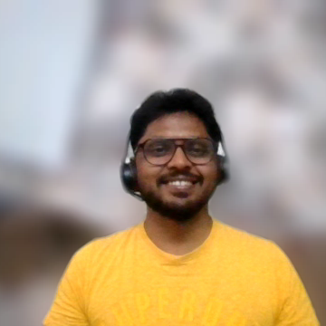
Requirements (Technical & Non-Functional)
Requirement Type | Description
TR-01 | System should support multiple fish farms in various locations.
TR-02 | System should support farms of varying sizes, from single farm customers to large clients with over a hundred farms.
TR-03 | System should support multiple enclosures for fish per farm, ranging from ten to over a thousand.
TR-04 | System should support large farms housing over a million fish.
TR-05 | System should support a variety of different fish species per farm.
TR-06 | System should integrate with water monitors in each enclosure to capture water quality information (PH, temperature, salinity, oxygen levels, etc.).
TR-07 | System should integrate with underwater cameras in each enclosure to monitor fish health (size, activity, parasite detection).
TR-08 | System should support a beta feature for individual fish identification via fish-ual recognition.
TR-09 | System should provide customizable dashboards for farmers to view collected information.
TR-10 | System should allow farmers to set alert thresholds for various factors, including PH levels and upcoming adverse weather events.
TR-11 | System should track information about fish harvested from each farm.
TR-12 | System should use harvested information and raw data to build models for optimizing harvests.
TR-13 | System should allow large customers to derive insights across multiple farms.
TR-14 | System should define a data transmission method for hardware devices for water information capture and fish behavior detection.
NFR-01 | System should generate alerts in a timely manner to prevent potential damage from sudden water quality degradation or adverse weather.
NFR-02 | System should be designed to work in remote locations with poor cellular signal.
NFR-03 | System should be scalable to support future expansion to cattle and aquarium fish health monitoring.
Support for geographically distributed farms.
Implementation of alerting and insights functionality.
Provision for local connectivity to monitor farm health during unstable cloud connectivity.
Flexibility in system design to adapt to various farming sectors such as cattle, poultry, etc.
Notes:
These are the requirements extracted from the problem statement and the business needs.
Support for geographically distributed farms.
Implementation of alerting and insights functionality.
Provision for local connectivity to monitor farm health during unstable cloud connectivity.
Flexibility in system design to adapt to various farming sectors such as cattle, poultry, etc.
Sreedhar will take over from here..

Slide 4
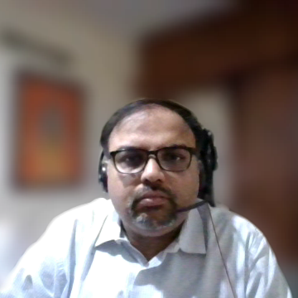

Architectural Characteristics
Availability
Performance
Data Consistency
Flexibility
Fault tolerance
Notes:
From the requirements that Nithin touched upon,
We infer that,
Fishwatch is a system designed to monitor farm health in real-time.
The system has several architectural characteristics, including
high availability,
performance,
data consistency and integrity,
Flexibility, and
fault tolerance.
These requirements have impacted the architecture of the system,
With the needs for load balancing, regional redundancies, and an Extract-Load-Transform (ELT) architecture for running the ML pipeline and analytics.
We also get an understanding that ,the system should be flexible , to support other farm verticals.

Slide 5
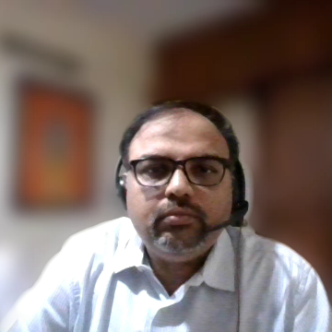
Architectural Style
Distributed microservices architecture
Event Driven Design
Notes:
From these architectural characteristics, we propose a distributed microservice architecture with an event-driven design.
Rationale for all the architectural decisions can be found in the architectural Decision Records in the submissions.

Slide 6
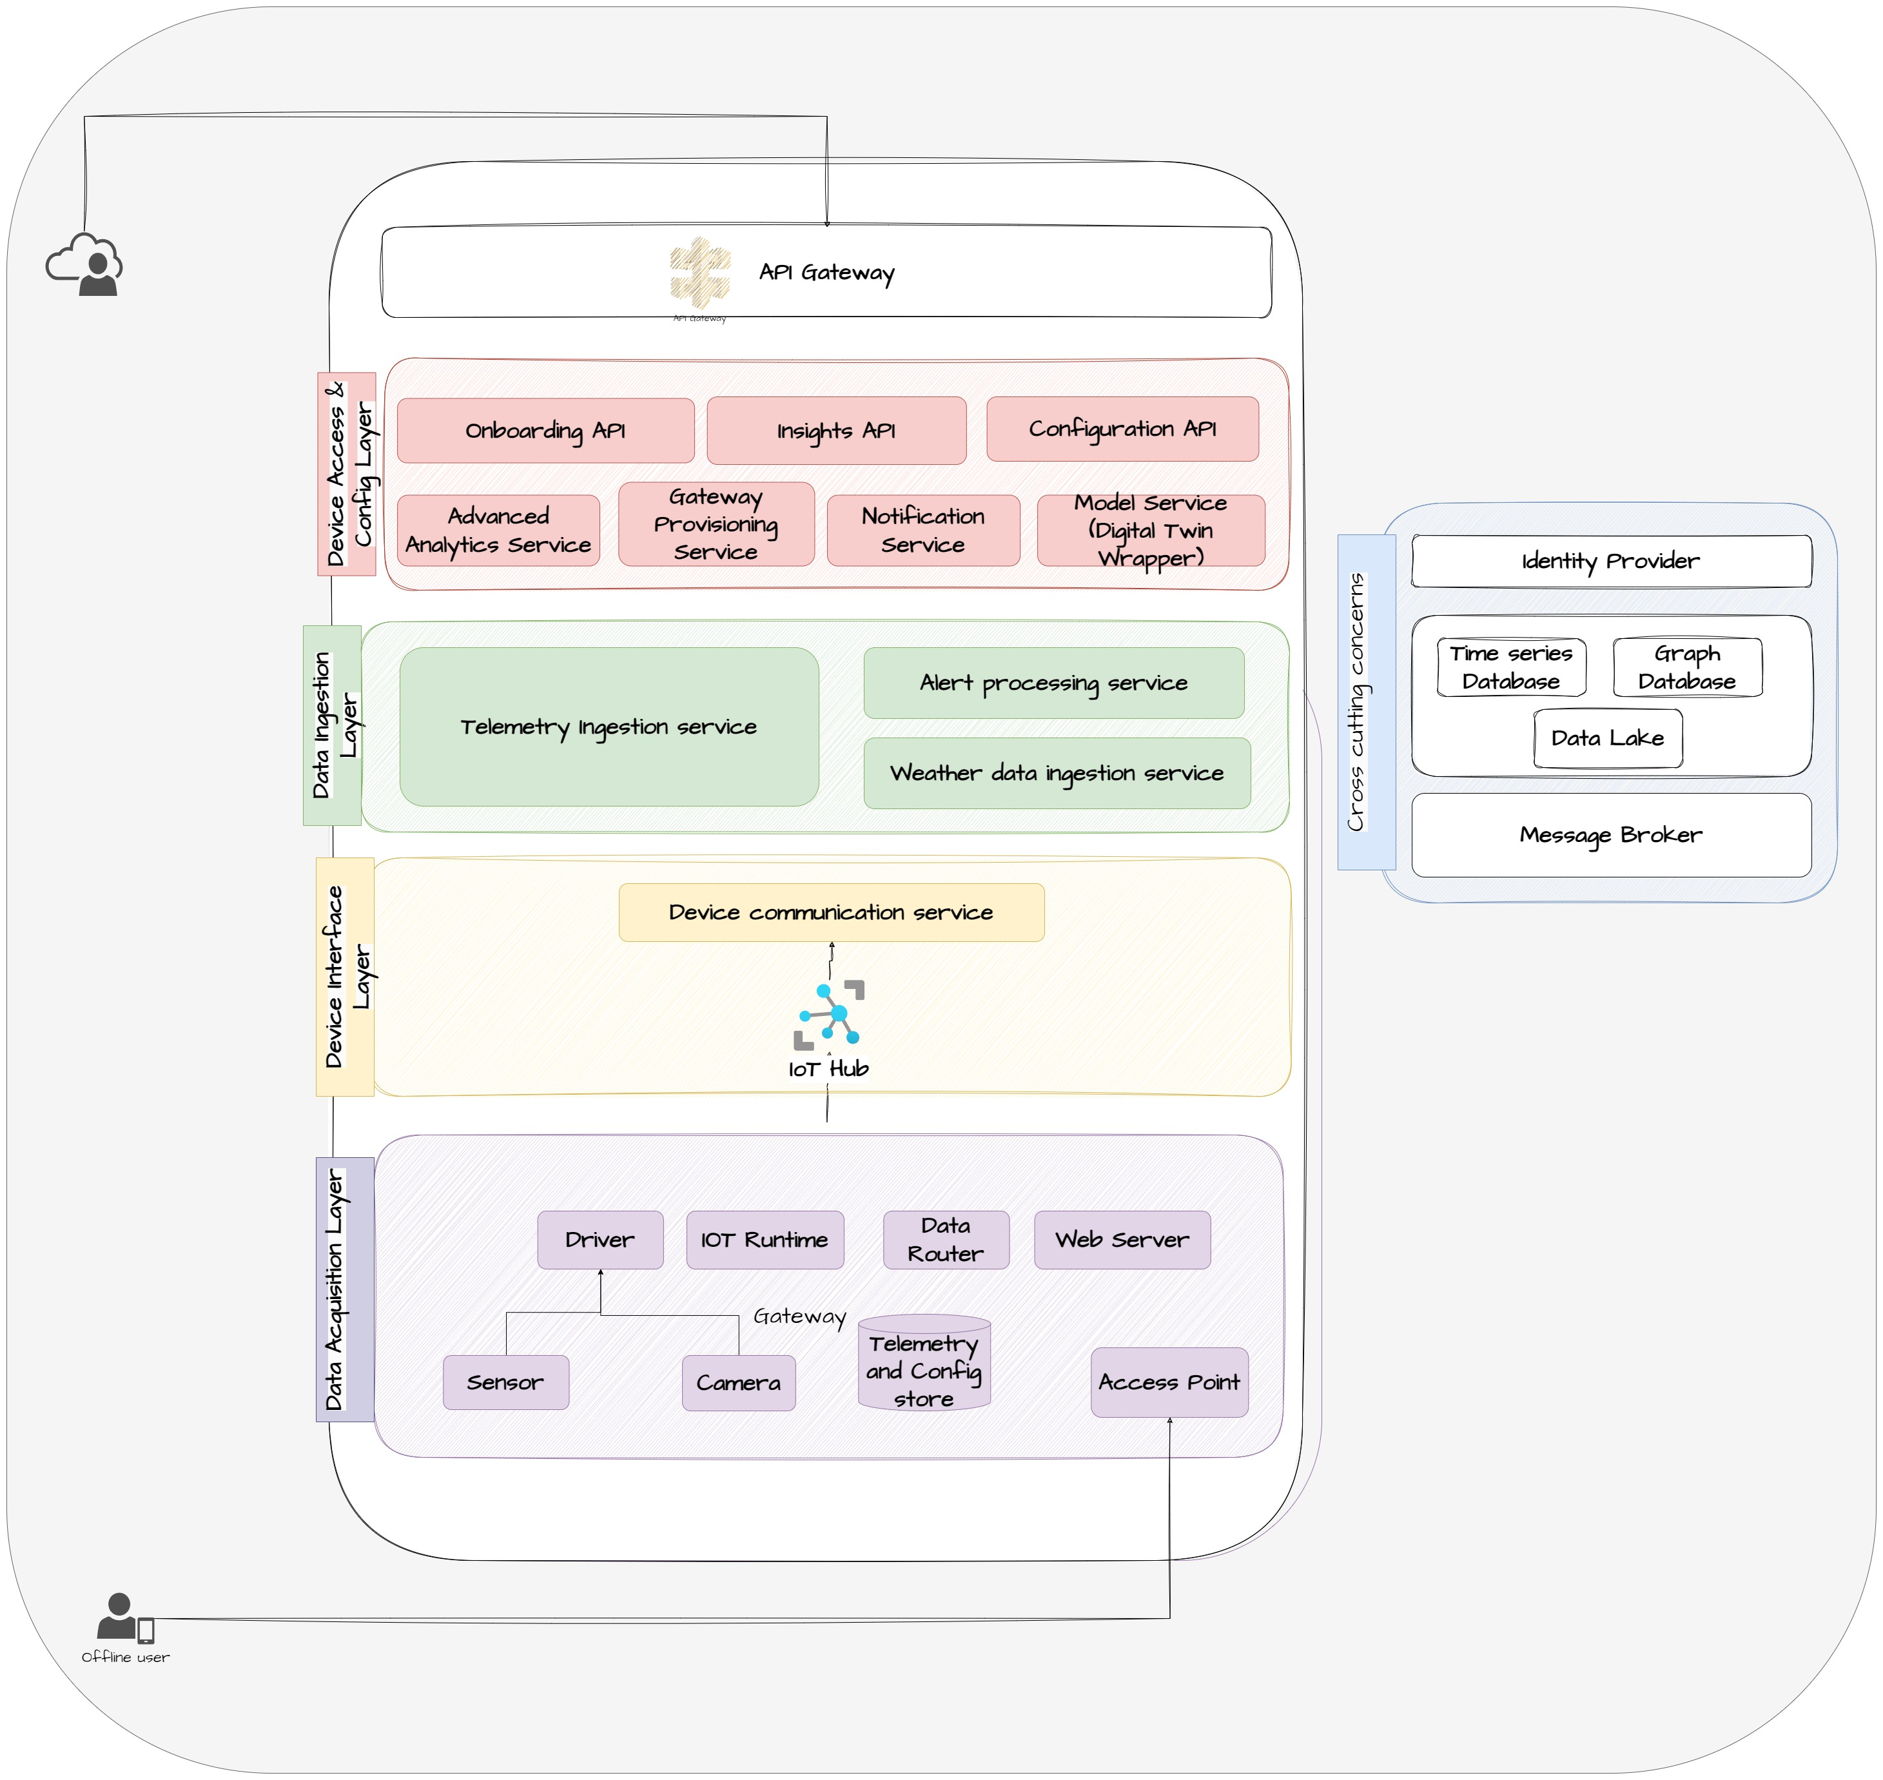
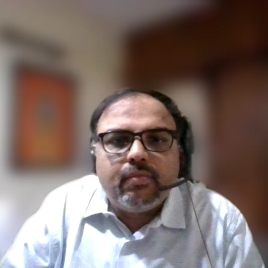
Component diagram
Notes:
Let us look at the Component diagram describing the building blocks for the system.
The Data Acquisition Layer.
The Device Interface Layer
The Data Ingestion Layer.
The Device Access and Config layer
The Cross Cutting Layer
each playing a crucial role.
It's like a well-choreographed act, with each component handling its part seamlessly.
From data acquisition to device management, real-time processing to user configurations,
we've got it all covered. Balan shall delve into more details from here..

Slide 7
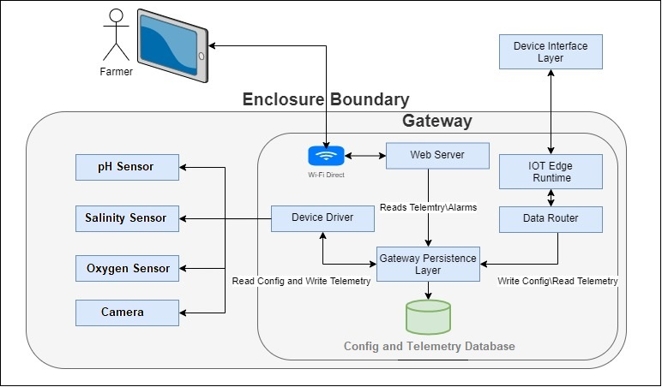
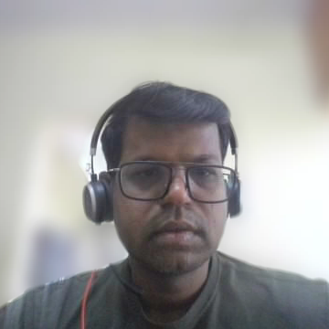
Data Acquisition Layer
Notes:
The primary function of the Data Acquisition Layer is to interface with various sensors and cameras, collecting health data and snapshots from the enclosures. It also triggers rule-based alerts if any sensor exceeds a set threshold or reports a malfunction.
In situations of poor network connectivity, the system ensures the persistence of telemetry data, even if the Gateway cannot establish a connection with the Cloud. It also hosts a local web server, providing the capability for farmers to connect their handheld devices to the Gateway. This allows them to monitor the health of the enclosures locally.

Slide 8
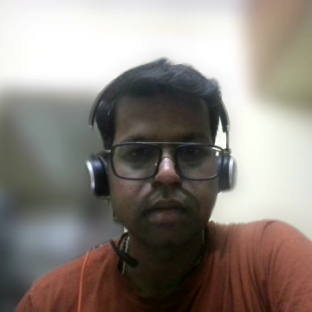
Device Interface Layer
Notes:
Moving on to the Device Interface Layer, this layer is responsible for receiving sensor data from multiple Gateways within a region. These devices generate a vast amount of data, including telemetry of sensor values and alerts. This data needs to be ingested, processed, and acted upon in real-time.
Choosing the right IoT platform is crucial for ensuring scalability, reliability, security, and interoperability. We chose Azure IoT hub. I would invite “Suresh” to explain about “Data Ingestion Layer”

Slide 9
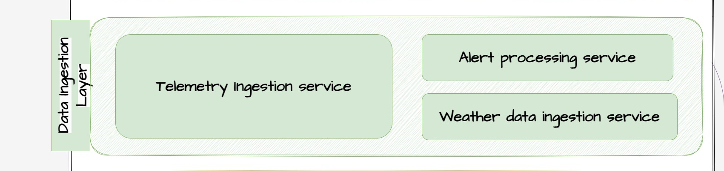
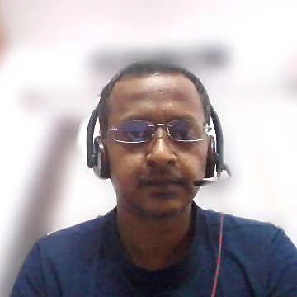
Data Ingestion Layer
Notes:
The Data Ingestion Layer contain three services:
Telemetry Ingestion Service: processing all sensor data forwarded by the gateway. It enriches this data and stores in a time series database.
Alert Processing Service enrich gateway alert data that forward to global notification service for immediate action and persist in a time series database.
Weather Data Ingestion Service: periodically fetches and stores weather information for all onboarded farm locations and this data is used by analytics service.
The Data Ingestion Layer is designed for deployment across various geographical locations. This distributed architecture allows us for data processing closer to the source, reducing processing latencies. Furthermore, these services built to scale on demand, dynamically adjusting its capacity to cater high volumes of data. Rahul will take over from here.

Slide 10
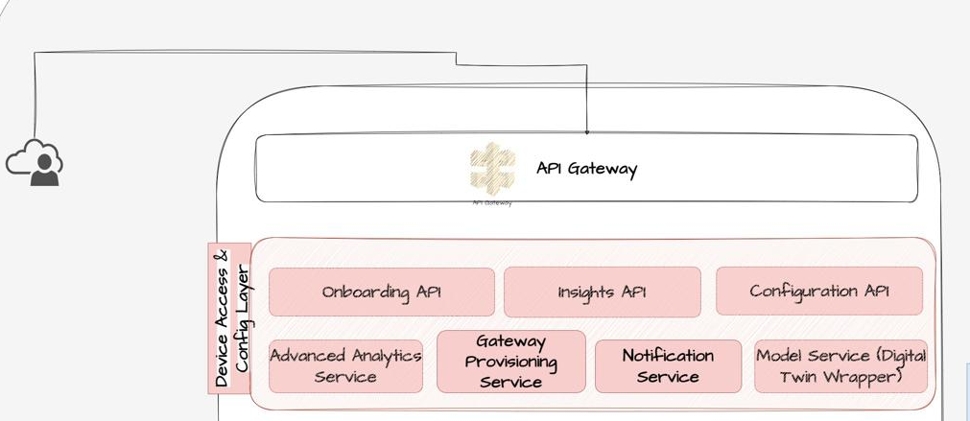
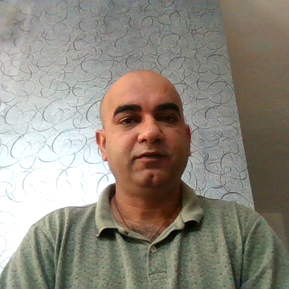
Device access and config Layer
Gateway Provisioning Service
Onboarding API
Configuration API
Insights API
Model Service
Notification Service
Advanced Analytics Service
API Gateway:
Notes:
Device Access and Config Layer, is composed of several services and APIs.
Insights API uses GraphQL to support user customizable views, reducing over-fetching and under-fetching issues.
The Model Service acts as a facade for the digital twin data stored in the graph database, managing interconnected data and handling complex relationships between entities.
Our Notification Service offers a comprehensive alert system, processing and delivering relevant alerts efficiently.
The Advanced Analytics Service aggregates telemetry data and uses machine learning to predict fish yield.
Finally, we have the API Gateway, which secures external requests to access the APIs, handling allow or deny list, rate limiting, basic parameter validation, and error handling.
Now, I will handover to Nithin.

Slide 11
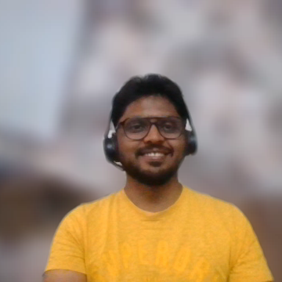
Architecture Highlights
Notes:
I will summarize key architecture highlights in our system design.

Slide 12
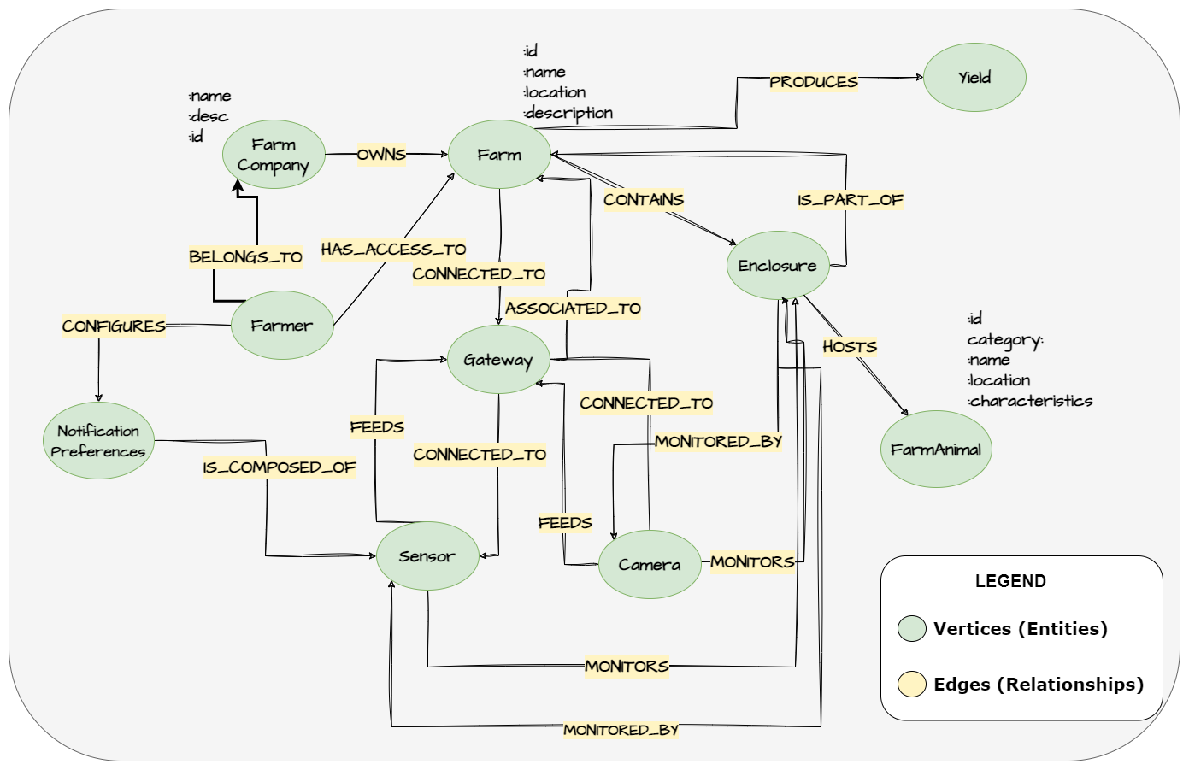
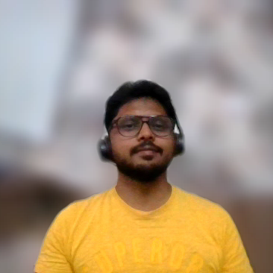
Flexibility
Notes:
Flexibility is a crucial characteristic of system design.
The heart of our system is the digital twin data. By keeping this generic, we can ensure support for any farm verticals.
Our core entities, such as sensors, cameras, gateways, enclosures, farms, and farm animals, are all designed to be generic.
Similarly, we've adopted the standard domain agnostic cloud event model as the schema for telemetry and alerts.
This broad design allows us to adapt to various farming sectors with ease.

Slide 13
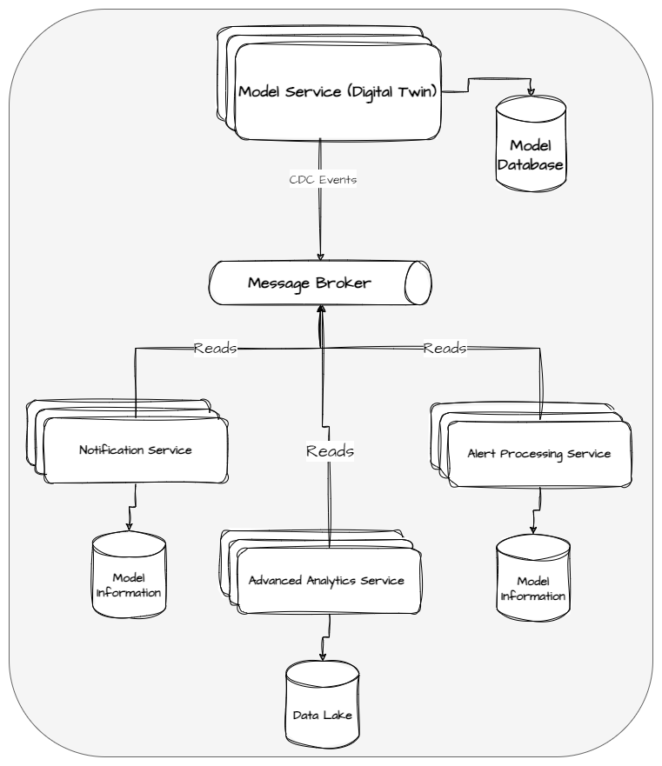
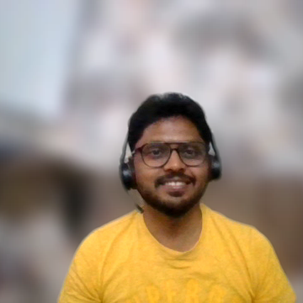
Scalability
Notes:
Our system uses event-driven, asynchronous communication for real-time processing and decoupling, thus ensuring microservices are loosely connected.
Core business microservices are self-contained, holding all data needed for their functions.
For example, the telemetry ingestion service keeps a copy of the digital twin data it needs to enrich events before persisting them.
It builds this data by processing change data capture events and saving only necessary details, allowing for easy scalability without impacting other services.

Slide 14
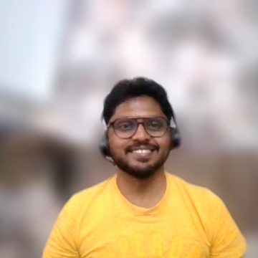
Conclusion
Notes:
To summarize, the proposed FishWatch architecture integrates the principles of microservices and event-driven design to provide a solution that is scalable, fault-tolerant, and high-performing. It successfully fulfills both the functional and non-functional requirements of the project.
Moreover, it guarantees data integrity and real-time processing, and it also offers predictive capabilities. This architecture is a comprehensive solution designed to address the complexities and challenges of modern fish farming.

